Slide 1
Making Documents Accessible
Accessibility matters and you can help!
Joe Lutovsky
Web Editor & Digital Accessibility Specialist

Slide 2

Why accessibility matters
One in Four adults have a disability
  Not all disabilities are visible, or disclosed
Accessibility benefits everyone
  “Curb-cut” effect
Accessibility in physical spaces is something most of us are familiar with
Digital accessibility is often less obvious
Our content should be as usable as possible
  There are many types of Assistive Technologies
  We must adhere to the standards that allow those technologies to work properly
    Web Content Accessibility Guidelines (WCAG)
Notes:
One in four adults has a disability according to the CDC. Not all disabilities are visible.
auditory, cognitive, learning, neurological, physical, speech, visual,
Temporary disabilities are more common than you might think.
When you help someone, you help everyone. Aunt May Parker
When we make the world better for those of us with disabilities, we make the world better for everyone.
Have you used an elevator? A cut-in in the sidewalk? Electric toothbrush, automatic door, subtitles?
Digital Accessibility is often less obvious. An obvious example of digital accessibility, is subtitles.

Slide 3

PDF accessibility basics
I’m a problem!

Slide 4
What is a PDF?
Portable Document Format
Designed to be able to present or exchange documents independent of software or hardware
The visual design of your PDF is preserved when viewed across platforms
These features can cause accessibility issues because PDFs tend to be far less adjustable than other means of presenting data
PDFs are super common outputs from lots of different programs
Notes:
The creator has presentation control
These features can cause accessibility issues because PDFs tend to be far less adjustable than other means of presenting data, such as an HTML webpage. Users can’t change them to their preferences as easily

Slide 5

Issues with PDF accessibility
Making PDFs accessible for users with disabilities can be a lot of work, particularly with more complex PDFs
PDFs are especially hard to use on mobile
  iOS and Android text to speech functions don’t fully support PDFs at this time so this can prevent users with low vision from accessing these
Tools needed to make PDFs more accessible tend to be paywalled
I don’t want to play with you

Slide 6

Start with Word
Before saving your PDF, make sure the source document is as accessible as possible.
Set a title
Use STYLES for elements such as Headings and lists
Add alt text to images
Make sure tables have table headers and don’t use merge-cells
Consider your use of color/contrast
Save as tagged PDF
InDesign has similar options
Notes:
Making a Word document accessible and then turning it into a PDF is easier than making a PDF accessible
Word has it’s own accessibility checker tool.
The fundamentals here apply to sending Emails as well!

Slide 7
Ok so we’re stuck with a PDF. What does it need to be accessible?
Searchable (machine readable) Text
  Scan and OCR
Navigational Aids (headings, bookmarks, table of contents)
Accurate Metadata: Title and Language
Tags
Logical reading order
Alt text for images/charts
Properly formatted tables
Links can be tabbed through with keyboard
Good color contrast
Ok we can be friends
Notes:
The most accessible PDF is one that we decided to just use a different document format for :P
tags are invisible labels that talk to screen readers and braille displays
Explore these things with the easy examples and then the scanned example
OCR demo
Tagging Demo
Title and Language
Reading Order Demo
Alt Text

Slide 8
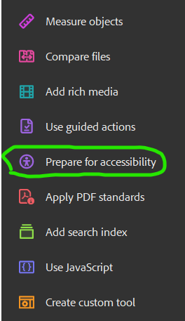
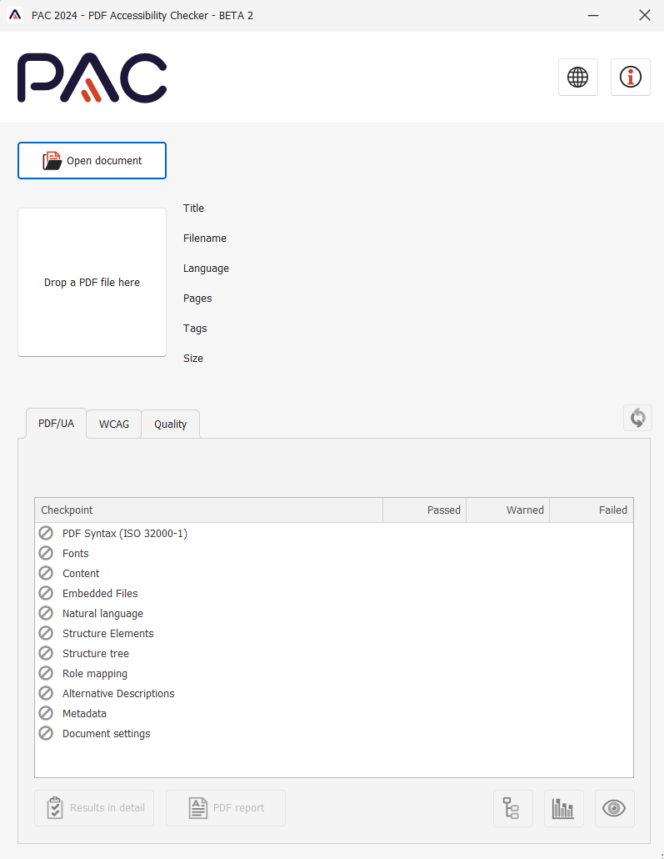
Checking PDFs for accessibility
Adobe Acrobat Pro “Check for Accessibility” tool
  Always your first step
Won’t necessarily catch all issues but it’s a great start
PAC: free third party pdf checker for PC
  Includes color contrast checker and screen reader preview mode
Color contrast: at least 4.5:1 (3:1 for large text)
Notes:
it can see alt text, but not tell you if it’s any good, and at the moment, don’t trust any tool that claims to!
Everything you do is better than doing nothing

Slide 9
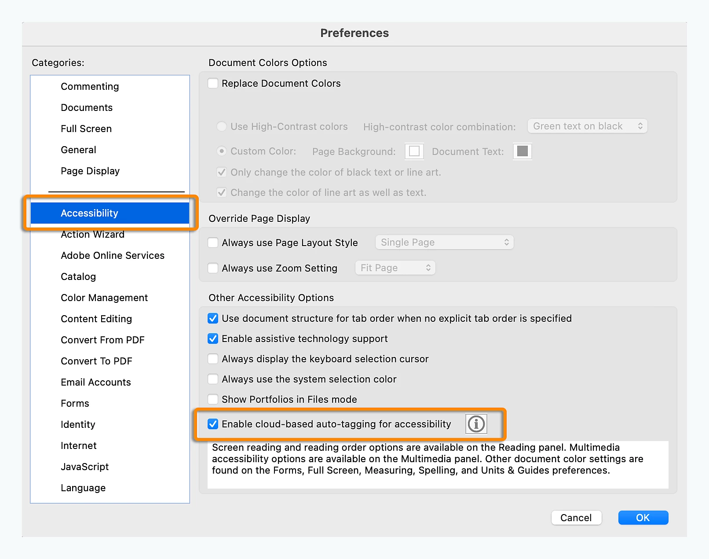
Tagging in PDFs
Need Acrobat Pro
Make it in Word first if possible
Tags are invisible labels that talk to assistive technology (paragraphs, headings, etc)
Accessibility Tags Pane in Acrobat
  Tag order is the reading order for assistive tech.
  Fix reading order button
  Automatically tag untagged PDFs (not great but better than nothing)

Slide 10
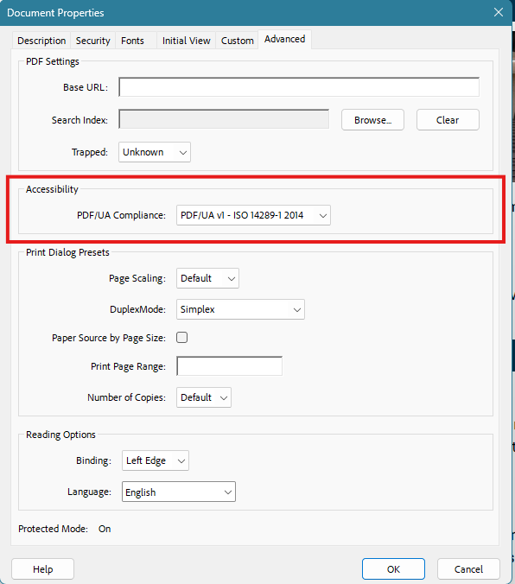
PDF/UA
Universal Accessibility
UA Identifier is your last step
Equivalent to WCAG 2.0

Slide 11
Summary
Ask yourself if PDF is really needed
Do as much accessibility work in the source document before turning it into a pdf
Use automated checkers to get a first pass on your document but use that to inform manual checks and fixes
Notes:
it can see alt text, but not tell you if it’s any good, and at the moment, don’t trust any tool that claims to!
Everything you do is better than doing nothing

Slide 12
Resources
Adobe: PDF accessibility overview
Section508.gov: Create accessible PDFs
PAC 2024 PDF checker
Tagged PDF site
Contrast Checker
Color Contrast Analyser

