Slide 1
Accessible PowerPoint Presentations
Accessibility matters and you can help!
Joe Lutovsky
Web Editor & Digital Accessibility Specialist

Slide 2

Why accessibility matters
One in Four adults have a disability
  Not all disabilities are visible, or disclosed
Accessibility benefits everyone
  “Curb-cut” effect
Accessibility in physical spaces is something most of us are familiar with
Digital accessibility is often less obvious
Our content should be as usable as possible
  There are many types of Assistive Technologies
  We must adhere to the standards that allow those technologies to work properly
    Web Content Accessibility Guidelines (WCAG)
Notes:
One in four adults has a disability according to the CDC. Not all disabilities are visible.
auditory, cognitive, learning, neurological, physical, speech, visual,
Temporary disabilities are more common than you might think.
When you help someone, you help everyone. Aunt May Parker
When we make the world better for those of us with disabilities, we make the world better for everyone.
Have you used an elevator? A cut-in in the sidewalk? Electric toothbrush, automatic door, subtitles?
Digital Accessibility is often less obvious. An obvious example of digital accessibility, is subtitles.

Slide 3
Contrast and use of Color
People with low vision and colorblindness
3:1 for large text
4.5: 1 for small text
Poor color contrast can impact the ability of users with different visual impairments from perceiving your content properly.
Notes:
Industry standards for color contrast ratios.

Slide 4
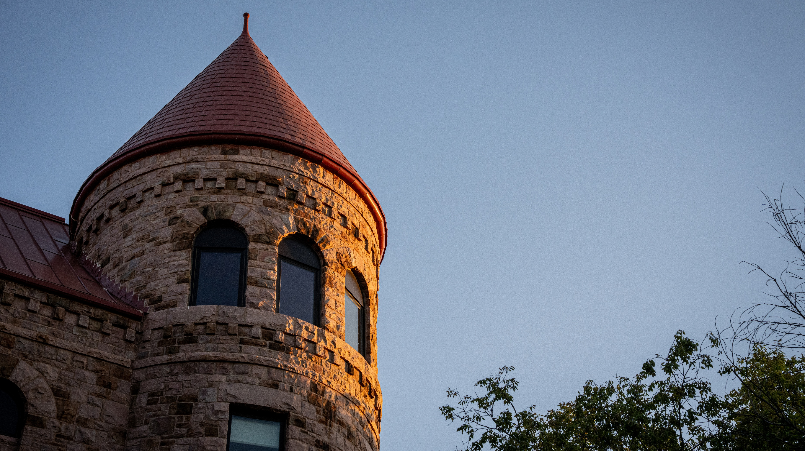
“It doesn't matter what you do...so long as you change something from the way it was before you touched it into something that's like you after you take your hands away.”
― Ray Bradbury, Fahrenheit 451
Notes:
When text in a text box with a transparent fill is placed onto other elements, you need to measure contrast manually

Slide 5
Use Accessibility Checker to find common color issues
Smart Art
Diagram
Diagram
Smart Art
Text with or without highlights and hyperlinks
In text boxes, shapes, tables, and SmartArts
With solid, opaque colors
Text box
Shape
Text box with highlights
Text box with hyperlinks
Table Style
 | Table Cell

Slide 6
Accessibility Checker can’t do it all
Transparency
Nonsolid fills
Graphics
Text in charts
Composition of multiple objects and the background
Gradient Fill
Transparent Fill
Composition
Notes:
If you’re not sure, check it manually using the analyzer we looked at earlier

Slide 7
What to do if you’re struggling with homework
Give Up
Take a Nap
Ask for Help
Notes:
Grayscale filter simulates monochromacy
Color should never be the only element you’re using to convey information

Slide 8



What to do if you’re struggling with homework
Give Up
Take a Nap
Ask for Help
Notes:
Grayscale filter simulates monochromacy
Color alone should never be the only element you’re using to convey information

Slide 9

Make it work with a screen reader
Each slide needs a unique and meaningful title
Alt text
Logical reading order
Proper linking
  https://www.namitjain.com/tools/url-lengthener/r/temp/scripts/you/thing/folders/going/nested/logs/click/keeps/logs/temp/very/deluxe/plus/assets/click/scripts/keeps/deep/if/profile/very/assets/critical?data=aHR0cHMlM0ElMkYlMkZkc3UuZWR1JTJG&utm_source=infinite&utm_medium=spaghetti&utm_campaign=hyper-elongation&cachebust=1772473123682&meta=loremipsumdolorsitamet
Notes:
Meaningful logical order. Textual descriptions
Slide Title fixing example. Hidden titles are necessary.
Reading order example on accessibility color slide

Slide 10
Make it work with a screen reader
Making presentations accessible is a lot to think about | Doing the work makes the world better for everyone
Sitting through long trainings is boring | Joe appreciates you sticking this out

Slide 11
Make it work with a screen reader
Challenge | Opportunity
Making presentations accessible is a lot to think about | Doing the work makes our university better for everyone
Sitting through long trainings is boring | Joe appreciates you sticking this out
Notes:
Screen readers read the heading out before each item to make it easier to follow the table.
Don’t merge cells

Slide 12
Additional considerations
Add captions to videos
Consider neurodivergent audiences
  Large walls of text can be overwhelming or distracting
Avoid animations
Describe visuals aloud when presenting

Slide 13
Resources
Color Contrast Analyser
Contrast Checker
Microsoft PowerPoint Accessibility Documentation

